Slide 1
CGB1201 – JAVA PROGRAMMING FINAL REVIEW
Department of Computer Science and Engineering
Academic Year: 2024 – 2025 (Odd Semester)
Register Number :8115U23AM041
Name :SADIQUL AMEEN M
Year :II
Semester :III
Date :05/12/2024

Slide 2
PARCEL TRACKING SYSTEM
ABSTRACT
INTRODUCTION
CONCEPTS USED
PROPOSED ARCHITECTURE
PROPOSED ARCHITECTURE – DESCRIPTION
LIST OF MODULES
MODULE DESCRIPTION
RESULT
CONCLUSION

Slide 3
Abstract
A Parcel Tracking System is a technology-driven solution designed to monitor and manage the movement of parcels from dispatch to delivery. It integrates GPS, barcoding, and real-time data updates to ensure accurate tracking at every stage. Customers and logistics teams can access the parcel's status through a user-friendly interface. The system improves efficiency, minimizes delays, and enhances transparency in the supply chain. It is widely used in e-commerce, courier services, and logistics industries.

Slide 4
Abstract with CO/PO Mapping
Abstract | CO | POs | PSO
A Parcel Tracking System is a technology-driven solution designed to monitor and manage the movement of parcels from dispatch to delivery. It integrates GPS, barcoding, and real-time data updates to ensure accurate tracking at every stage. Customers and logistics teams can access the parcel's status through a user-friendly interface. The system improves efficiency, minimizes delays, and enhances transparency in the supply chain. It is widely used in e-commerce, courier services, and logistics industries | CO1 CO2 CO3 CO4 CO5 | PO2 PO3 PO4 PO5 | PSO1 PSO2 PSO3

Slide 5
Introduction
A Parcel Tracking System is an innovative solution that simplifies the process of monitoring parcels during transit. It leverages technologies like GPS, RFID, and barcoding to provide real-time updates on a parcel’s location and status. This system ensures transparency, reliability, and efficiency in logistics and delivery operations. By offering easy access to tracking information, it enhances customer satisfaction and trust. Widely adopted in e-commerce and courier industries, it plays a critical role in modern supply chain management.

Slide 6
Java Programming - Concepts Used
In a Parcel Tracking System, Java programming leverages key concepts like:
Object-Oriented Programming (OOP): Classes and objects represent parcels, users, and tracking systems.
Database Connectivity: JDBC is used to connect and manage parcel data stored in databases.
Multithreading: Ensures efficient real-time tracking and data updates for multiple users.
Networking: Facilitates communication between servers and clients for location updates.
APIs and Libraries: Integration with APIs (e.g., Google Maps) for route and location visualization.

Slide 7
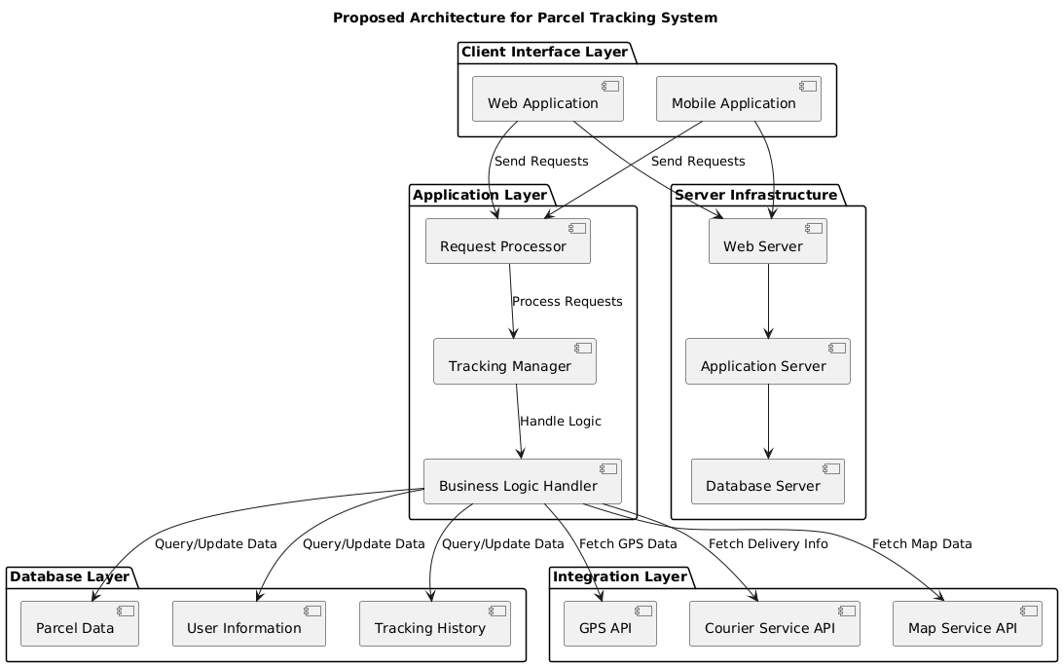
Proposed Architecture

Slide 8
Proposed Architecture - Description
The proposed architecture for a Parcel Tracking System is designed to ensure efficient and real-time parcel tracking with a modular and scalable approach. Here’s a detailed description:
Client Interface Layer: This layer includes web and mobile applications that provide users with an intuitive interface to track parcels, view delivery details, and manage their accounts. It acts as the entry point for both customers and system administrators.
Application Layer: This is the core of the system, responsible for processing user requests, managing business logic, and tracking parcel statuses. Key components include a Request Processor to handle incoming requests, a Tracking Manager to update and retrieve parcel statuses, and a Business Logic Handler to enforce rules and coordinate between layers.

Slide 9
Proposed Architecture - Description (Cont..)
Database Layer: This layer stores and manages all data related to parcels, users, and tracking history. It ensures data consistency and security, enabling efficient queries and updates through structured tables for parcel information, user details, and tracking logs.
Integration Layer: This layer connects the system to external services and APIs, such as GPS for real-time parcel location updates, courier networks for delivery information, and mapping services for route visualization. It ensures seamless communication with third-party systems to enhance functionality.
Server Infrastructure: The system is hosted on a cloud-based or on-premise infrastructure, including web servers for handling client requests, application servers for business logic processing, and database servers for data storage. This architecture ensures scalability, reliability, and real-time updates for multiple users simultaneously.
This layered design supports a modular and robust framework, enabling easy maintenance, future upgrades, and high performance in the logistics and delivery ecosystem.

Slide 10
List of Modules
User Management Module
Parcel Management Module
Tracking Module
Notification Module
Integration Module
Route Optimization Module
Payment Module
Reporting and Analytics Module
Admin Dashboard Module

Slide 11
Module Description
User Management Module
Handles user registration, login, and account management. Differentiates roles for customers, administrators, and delivery agents.
Parcel Management Module
Allows parcel creation, labeling, and assignment to delivery agents.Stores and manages parcel details like sender, receiver, weight, and dimensions.
Tracking Module
Provides real-time parcel location updates.Tracks parcel movement across various checkpoints (e.g., warehouse, transit).
Notification Module
Sends updates to users via SMS, email, or app notifications.Alerts users about delivery status changes or delays.
Integration Module
Connects with GPS services for location tracking.Integrates with courier networks and external APIs (e.g., maps, logistics platforms).

Slide 12
Module Description (Cont..)
Route Optimization Module
Calculates optimal delivery routes to reduce transit time and costs.Updates delivery agents with dynamic route changes based on traffic or delays.
Payment Module
Handles payment processing for delivery charges.Provides options like online payment, cash on delivery, or prepaid services.
Reporting and Analytics Module
Generates reports on delivery performance, delays, and operational metrics.Provides insights for improving efficiency and customer satisfaction.
Admin Dashboard Module
Provides system administrators with tools to monitor and control the system.Manages user accounts, delivery agent assignments, and operational settings.

Slide 13
Results and Discussion
Results
Real-Time Tracking The system provides accurate, real-time updates on parcel location and status, enhancing transparency and user satisfaction. Customers can easily track parcels through the web or mobile interface.
Improved Delivery Efficiency Integration with GPS and route optimization modules ensures faster and more efficient deliveries, reducing delays and operational costs.
Enhanced User Experience User-friendly interfaces and timely notifications keep customers informed about their parcel’s journey, improving engagement and trust in the system.
System Scalability The modular architecture allows the system to handle increasing parcel volumes and user traffic without compromising performance.
Seamless Integration The system successfully integrates with third-party APIs, such as courier networks and mapping services, for better functionality and real-time updates.

Slide 14
Results and Discussion (Cont..)
Discussion
Impact on Logistics Operations The system streamlines logistics processes by automating parcel tracking and reducing manual errors. It significantly improves supply chain visibility for businesses.
Customer-Centric Approach Real-time updates and personalized notifications align with user expectations, fostering customer satisfaction and loyalty in industries like e-commerce and courier services.
Challenges Encountered
Data Synchronization: Ensuring real-time data updates across multiple systems required robust database and API handling.
Scalability: Initial system tests highlighted the need for optimized server configurations to handle peak loads efficiently.
Security: Implementing encryption and authentication protocols was critical to safeguard sensitive user and parcel data.
Future Improvements
Implementing AI-based predictions for delivery time estimation.
Enhancing route optimization with advanced traffic analysis tools.
Adding multilingual support for broader accessibility.

Slide 15
Conclusion
The Parcel Tracking System enhances the efficiency and transparency of logistics operations by providing real-time parcel tracking and notifications. It improves customer satisfaction through user-friendly interfaces and timely updates. The system’s modular architecture ensures scalability, allowing it to handle increasing traffic and parcel volumes. Integration with external services like GPS and mapping APIs further optimizes delivery processes. Overall, it streamlines parcel management, reduces delays, and offers significant operational benefits to businesses in e-commerce and courier services.

Slide 16
Thank You
Any queries???

